Slide 1
Data Acquisition & Data Wrangling
Presented by:- Surabhi Patil

Slide 2
Objectives:
The objectives of this project are to do Data Acquisition and Data Wrangling on dataset 1,2, and 3
Also need to Check skewness, Correlation analysis

Slide 3
Tools and Libraries used:
Tools:
Jupyter Notebook (interactive coding environment)
Python (programming language)
Libraries:
Pandas (data manipulation and analysis)
NumPy (numerical computations
SciPy (scientific computing, specifically for Spearman rank correlation)
Matplotlib (data visualization)
Seaborn (data visualization, specifically for heatmaps and pair plots)

Slide 4
Project Highlights:
Imported and merged datasets
Handled missing values and outliers
Removed constant columns and redundant data
Calculated Spearman rank correlations
Visualized relationships using heatmaps and pair plots

Slide 5
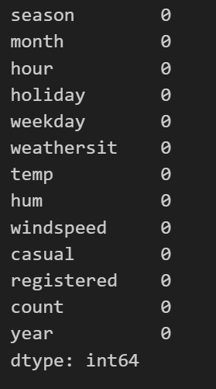
Missing Values Check:

Slide 6
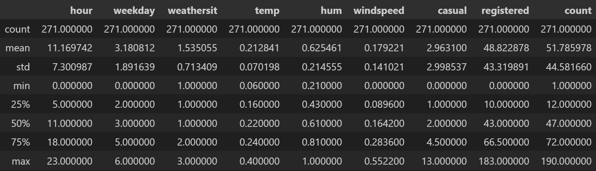
Data summary statistics:

Slide 7
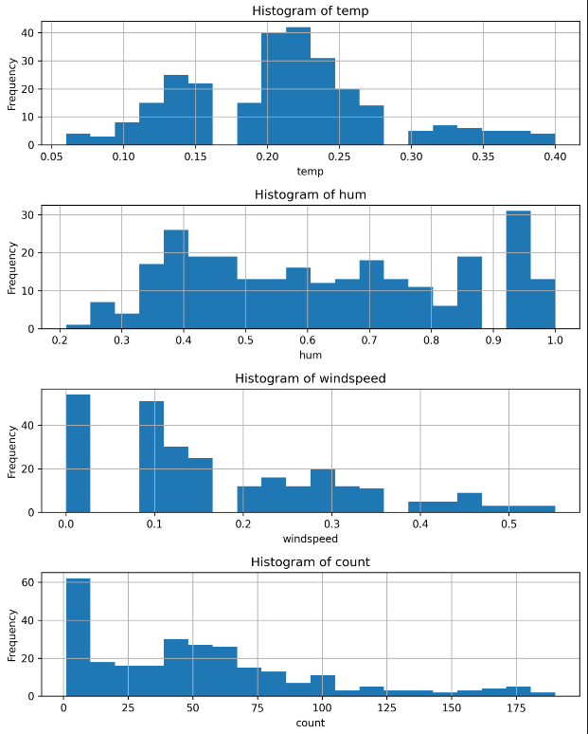
Distribution plots:

Slide 8
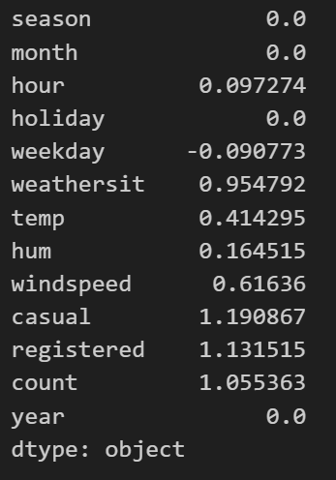
Skewness analysis:

Slide 9
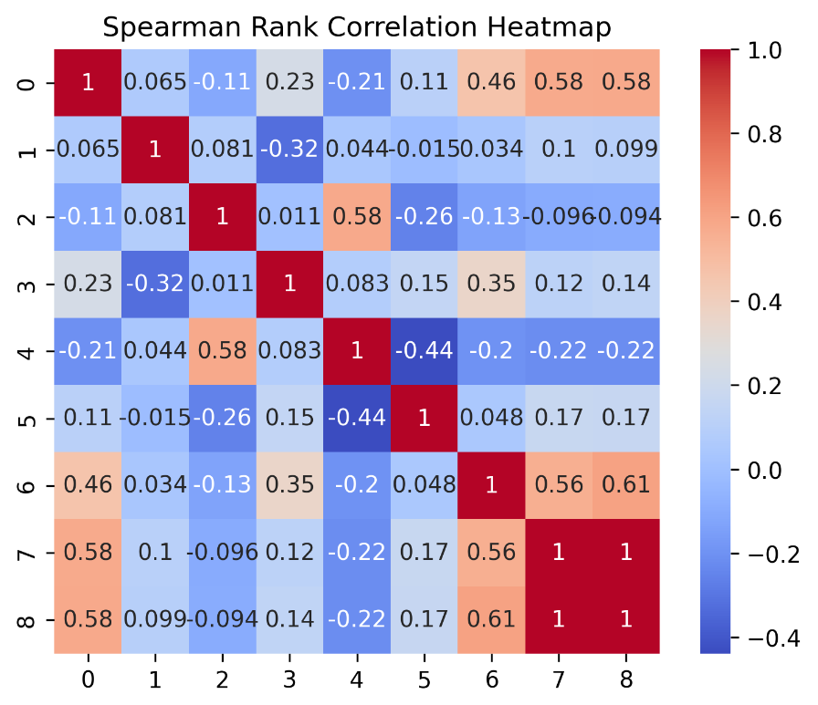
Heatmap of Spearman rank correlations:

Slide 10
Result:
The data is all cleaned now
The data is now ready to use for inspection and work on it
The dataset has a total of 271 rows and 9 columns

Slide 11
Conclusion:
This data wrangling project successfully cleaned, transformed, and prepared the Bike Rental dataset for analysis and modeling.
The resulting cleaned dataset provides valuable insights into bike rental patterns, including temporal trends, weather influences, and user demographics.

Slide 12


